Slide 1
New Wheel
Project Report
By: Soumit Kundu
Batch: AIML ONLINE SEPTEMBER 23 A

Slide 2
Business Overview
Total Revenue
82605431
Total Orders
1000
Total Customers
994
Avg Rating
3.135
Last Qtr Revenue
15182375
Last Qtr Orders
199
Avg Days to Ship
97.96
% Good Feedback
44.1%
By: Soumit Kundu
Batch: AIML ONLINE SEPTEMBER 23 A

Slide 3
Customer Metrics
By: Soumit Kundu
Batch: AIML ONLINE SEPTEMBER 23 A

Slide 4
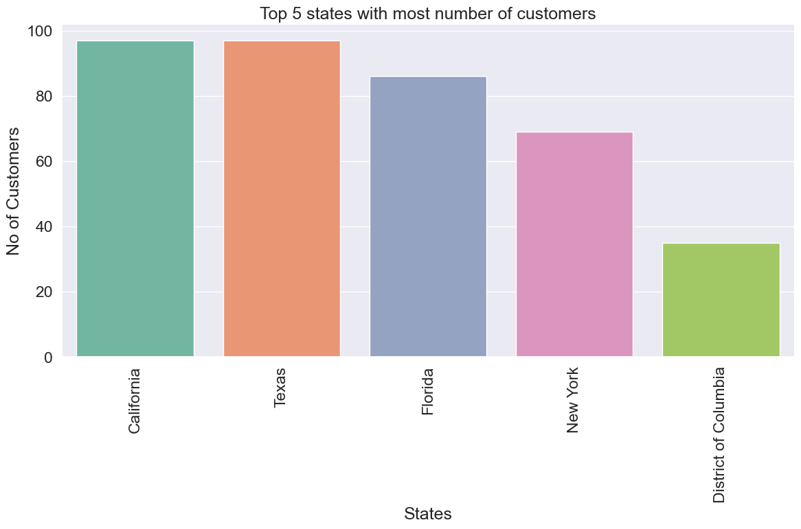
State wise Customer Distribution
By: Soumit Kundu
Batch: AIML ONLINE SEPTEMBER 23 A

Slide 5
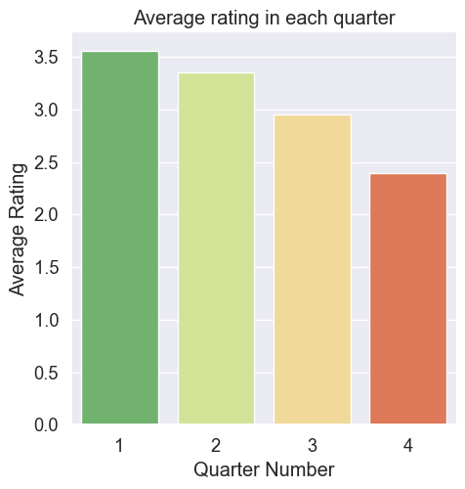
Average Customer Ratings by Quarter
By: Soumit Kundu
Batch: AIML ONLINE SEPTEMBER 23 A

Slide 6
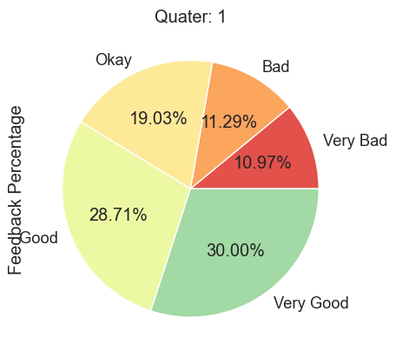
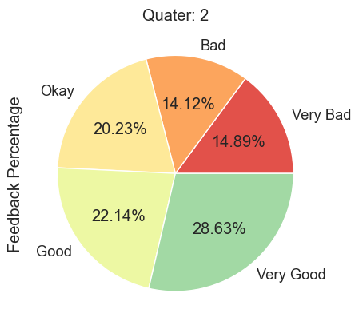
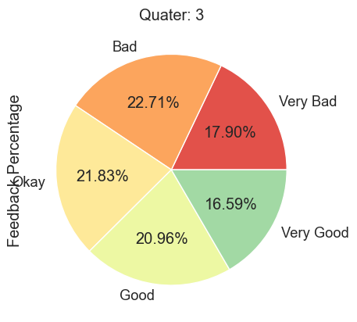
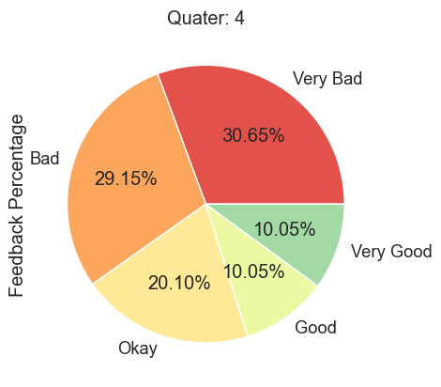
Trend of Customer Satisfaction
By: Soumit Kundu
Batch: AIML ONLINE SEPTEMBER 23 A

Slide 7
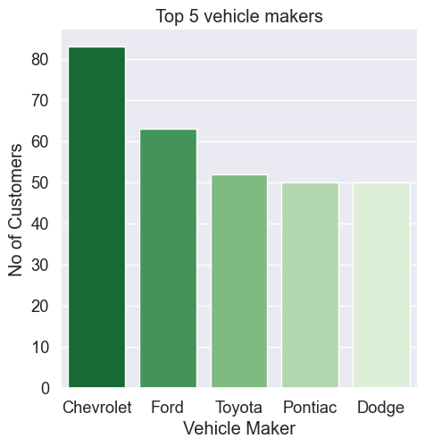
Top Vehicle makers preferred by customers
By: Soumit Kundu
Batch: AIML ONLINE SEPTEMBER 23 A

Slide 8
Most preferred vehicle make in each state
Showing some vehicle maker which are most preferred by 5 or more states with the state names
Vehicle Maker | State Count | State Names
Chevrolet | 17 | ['Alaska', 'Arkansas', 'California', 'Colorado', 'Connecticut', 'District of Columbia', 'Illinois', 'Iowa', 'Massachusetts', 'Missouri', 'Montana', 'Nebraska', 'Ohio', 'Texas', 'Utah', 'Washington', 'Wisconsin']
Dodge | 12 | ['Alabama', 'California', 'Idaho', 'Iowa', 'Kansas', 'Massachusetts', 'Mississippi', 'Montana', 'New Mexico', 'South Carolina', 'Utah', 'Wisconsin']
Ford | 10 | ['California', 'Hawaii', 'Illinois', 'Iowa', 'Kansas', 'Louisiana', 'Maryland', 'Michigan', 'North Dakota', 'Virginia']
GMC | 5 | ['Arkansas', 'Hawaii', 'Illinois', 'Kansas', 'Minnesota']
Mazda | 8 | ['Indiana', 'Iowa', 'Kansas', 'Oklahoma', 'South Carolina', 'Tennessee', 'Vermont', 'Wisconsin']
Mercedes-Benz | 6 | ['Kansas', 'Kentucky', 'Maine', 'Nebraska', 'New Jersey', 'West Virginia']
Nissan | 7 | ['California', 'Hawaii', 'Kansas', 'Kentucky', 'Louisiana', 'Nebraska', 'Wisconsin']
Pontiac | 11 | ['Arizona', 'Arkansas', 'Hawaii', 'Iowa', 'Kentucky', 'Louisiana', 'Nebraska', 'Nevada', 'New York', 'Utah', 'Wisconsin']
Toyota | 9 | ['Florida', 'Georgia', 'Hawaii', 'Mississippi', 'Nebraska', 'New York', 'Oklahoma', 'Oregon', 'Pennsylvania']
By: Soumit Kundu
Batch: AIML ONLINE SEPTEMBER 23 A

Slide 9
Revenue Metrics
By: Soumit Kundu
Batch: AIML ONLINE SEPTEMBER 23 A

Slide 10
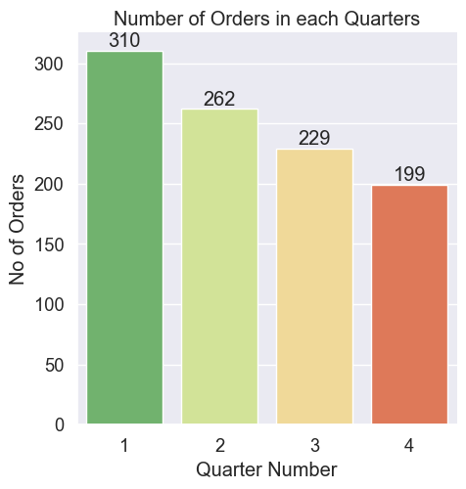
Trend of purchases by Quarter
By: Soumit Kundu
Batch: AIML ONLINE SEPTEMBER 23 A

Slide 11
Quarter on Quarter % change in Revenue
Quarter Number | Total Revenue | Previous Revenue | QoQ Change in %
1 | 26375015.66
2 | 21465757.27 | 26375015.66 | -0.186132909
3 | 19582283.12 | 21465757.27 | -0.087743196
4 | 15182375.04 | 19582283.12 | -0.224688207
By: Soumit Kundu
Batch: AIML ONLINE SEPTEMBER 23 A

Slide 12
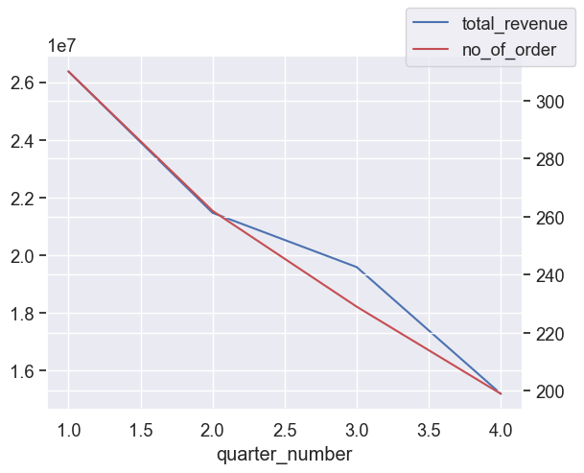
Trend of Revenue and Orders by Quarter
By: Soumit Kundu
Batch: AIML ONLINE SEPTEMBER 23 A

Slide 13
Shipping Metrics
By: Soumit Kundu
Batch: AIML ONLINE SEPTEMBER 23 A

Slide 14
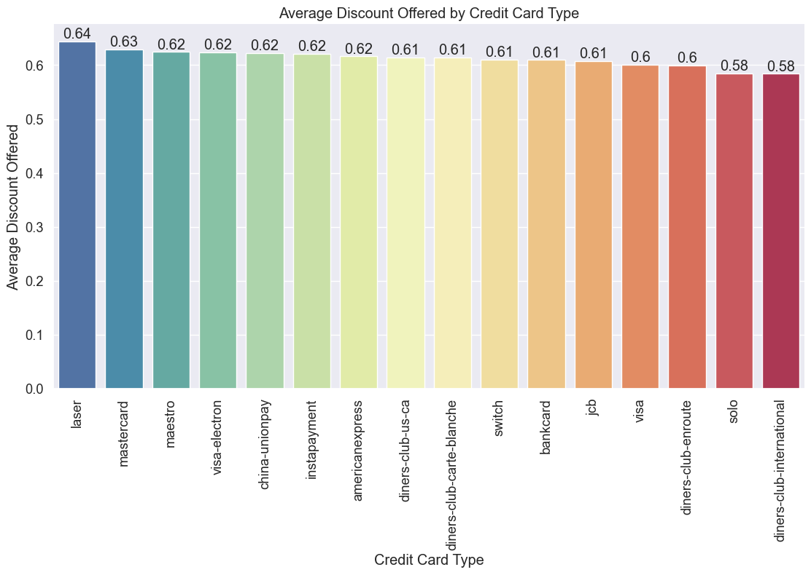
Average discount offered by Credit Card type
By: Soumit Kundu
Batch: AIML ONLINE SEPTEMBER 23 A

Slide 15
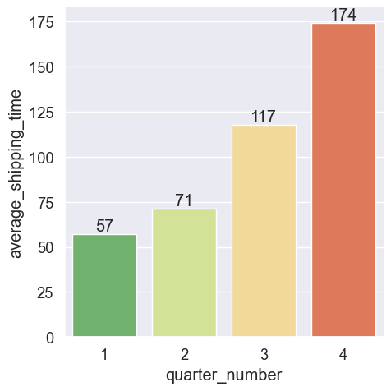
Time taken to ship orders by Quarter
By: Soumit Kundu
Batch: AIML ONLINE SEPTEMBER 23 A

Slide 16
Insights and Recommendations
We can see the average shipping time taken by the company is significantly going high over time.
So it is very natural that the customers will be frustrated and give bad feedback.
Company should take necessary action on this matter very seriously to perform well in the future.
By: Soumit Kundu
Batch: AIML ONLINE SEPTEMBER 23 A

